Slide 1

Sitecore 9.3 Training Day – 3 Personalization
Balaji Balasubramanian

Slide 2
Survey
About your Sitecore Digital Marketing experience
https://www.menti.com/fk55mxd7ce
Or
Go to www.menti.com and use the code 8093 3795

Slide 3
Agenda
Personalization
What's the need for personalization?
What is meant by Goals? Action , visit
Engagement Values , why its important ?
Demo on the Existing personalization
Live Session on New Goals
Create a new Goal
Assigning goal to a page
Goal based personalization
Create a personalization based upon Goals
Exploring other personalization rules.
Personalization based upon Campaigns
Multiple Rule Condition
At what stage we have to implement Personalization
Assessment – 10 Questions
Additional Topics
Further Connection

Slide 4
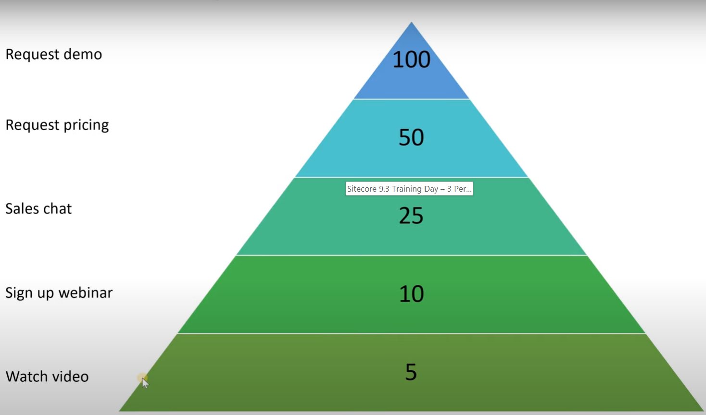
Engagement Values
Importance of engagement Values

Slide 5
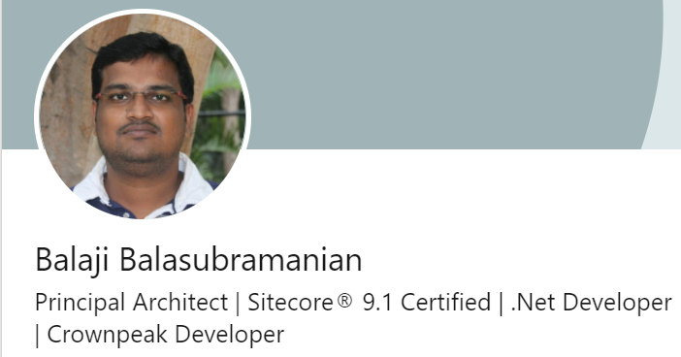
Further connection
Contact me
Email : sitecoregroot@gmail.com
Linked in : https://www.linkedin.com/in/balajisitecore/
Twitter : https://twitter.com/balajisitecore
Blog : https://balajibb.wordpress.com/

Slide 6
-Sitecore SXA – Developer -Sitecore SXA – Content Author - Sitecore developer – guidelines,optimization , Best practices - Sitecore EXM – Full fledged - Sitecore digital marketing – persona, Profile card, pattern card, campaign & other digital marketing - SITECORE PROJECT AUDIT - Etc .,☺ -- (Docker, jSS)
Other trainings

Slide 7
Thank you

